Slide 1
Data Structures and Algorithms -3 (25CS2103E)
Mini Search Engine/ Information Retrieval System
Team Members
Uppu Sindhuja- 2520080045
P. Bhagya Sri – 2520080024
Santosh – 2520090051
Under the Esteemed Guidance of
Dr. Dyuti Banerjee
Asst. Prof AI & DS

Slide 2
Contents
Abstract
Introduction
Literature survey
Problem Statement and Objectives
Hardware and Software requirements
Results
Conclusion
Future Scope

Slide 3
Abstract
WordVault is a website that stores Word documents on your computer and helps you find information in them quickly. It searches by keywords or exact phrases, suggests corrections for spelling mistakes, and finds documents with similar content. By indexing documents when they’re added, WordVault makes searching easier than opening files one by one.

Slide 4
Introduction
We often save many documents on our computers, and finding one specific file can take time. WordVault gives us one place to upload and manage Word documents, then search their contents in different ways. It uses indexing to find matching documents quickly, so users don’t have to open every file one by one.

Slide 5
Literature Survey
Many existing tools, such as Google Drive, DocFetcher, and Recoll, help users find files by searching their names or contents. Some tools also support phrase searches, spelling suggestions, and filters. These examples show that indexing documents can make searching faster than checking each file manually. Our project uses similar ideas in a simple website focused on storing and searching Word documents.

Slide 6
Problem Statement and Objectives
Problem statement:
When people have many Word documents, finding the right information can take a long time because they may need to open files one by one.
Objectives:
Our goal is to make document storage and searching easier. WordVault lets users upload, view, download, and delete Word documents. It also searches by keywords or exact phrases, suggests spelling corrections, and finds documents with similar content.

Slide 7
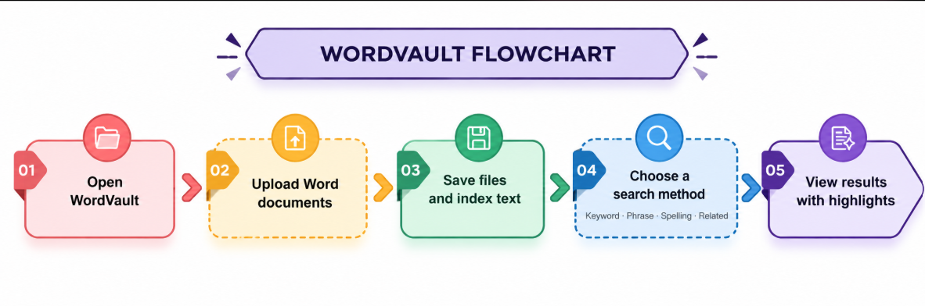
Flow Chart

Slide 8
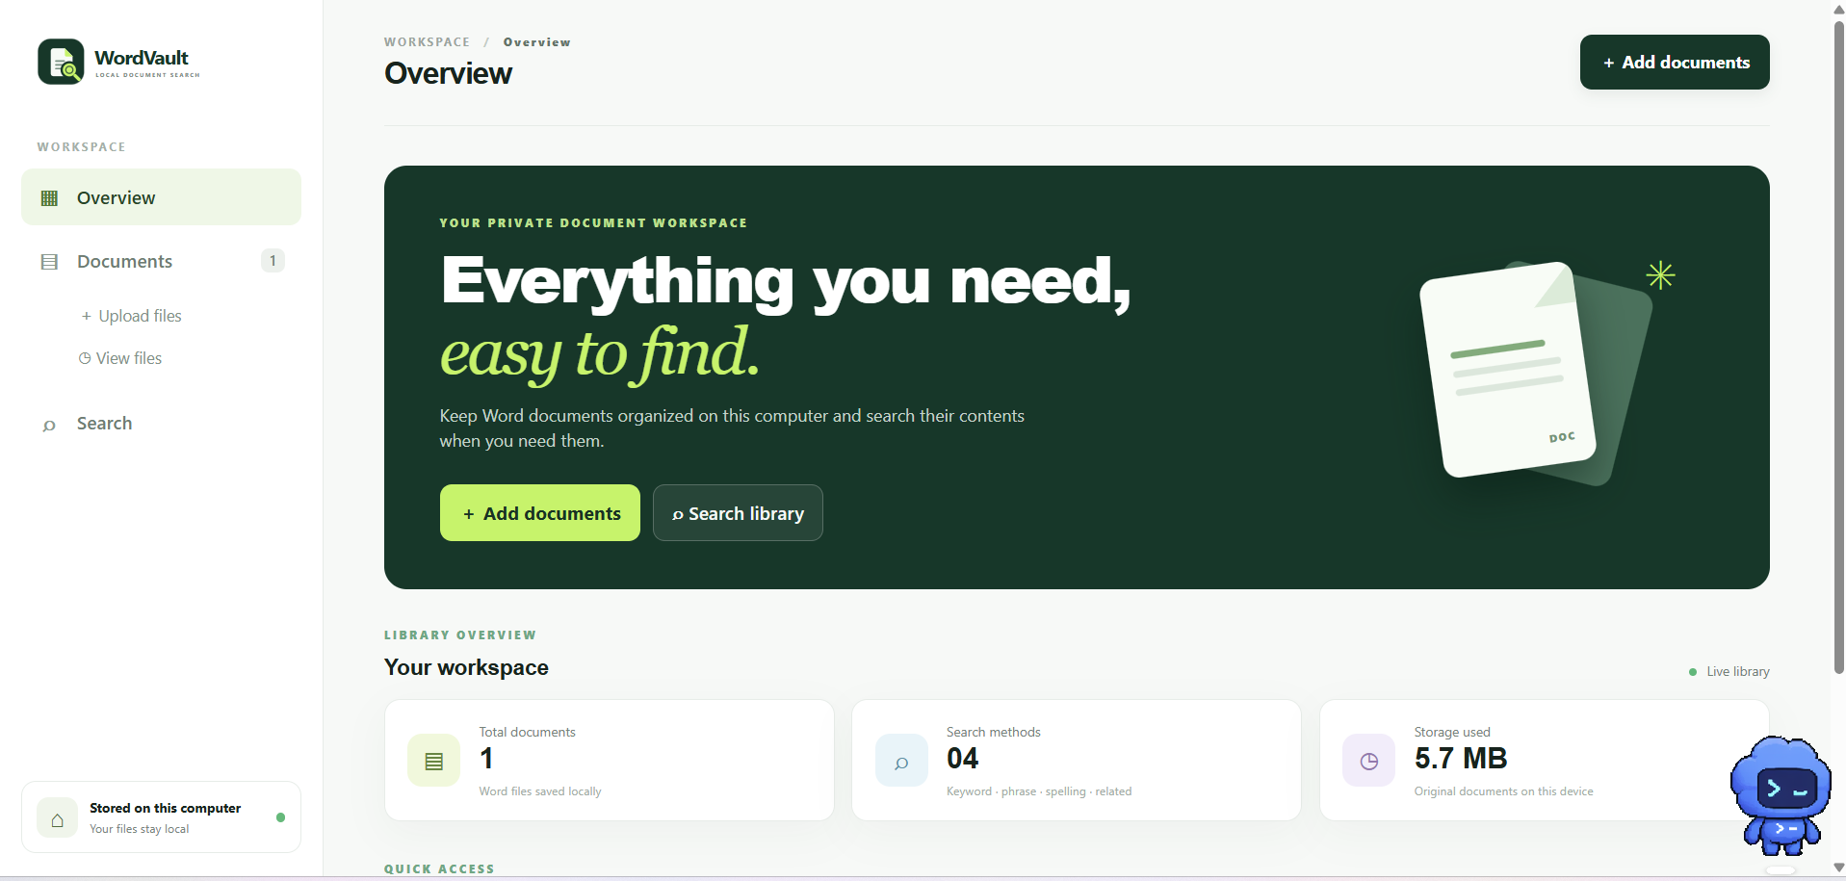
Results
WordVault stores uploaded Word documents and indexes their text for searching. Users can search by keyword or exact phrase, find spelling corrections, and discover related documents. Search results show matching documents, with the searched words highlighted for easier reading.

Slide 9
Hardware and Software requirements
Hardware Requirements
Computer with a dual-core processor or better
At least 4 GB RAM
500 MB of free storage for the application and documents
Software Requirements
Windows 10 or later
Java Development Kit (JDK) 17 or later
Apache Maven
Visual Studio Code
Modern web browser such as Chrome or Edge

Slide 10
Conclusion
Conclusion
WordVault provides a simple way to store Word documents and find information in them. It uses search techniques such as keyword and phrase matching, spelling correction, and related document search to help users find relevant files quickly.

Slide 11
Future Scope
Future Scope:
WordVault could be improved by supporting more file types, adding user accounts and secure cloud backups, and allowing document sharing. Search could also be enhanced with filters for date, file name, and document type.

Slide 12
Thank you

